Slide 1
ECON2026 Money and Banking
Lecture Notes 6

Slide 2
Monetary Policy Learning Objectives
Describe the goals of monetary policy.
Understand how Central Banks use monetary policy tools to influence the policy rate.
Trace how the importance of different monetary policy tools has changed over time.
Explain the role of monetary targeting in monetary policy.

Slide 3
The Goals of Monetary Policy
Six monetary policy goals:
Price stability
High employment
Economic growth
Stability of financial markets and institutions
Interest rate stability
Foreign-exchange market stability

Slide 4
The Goals of Monetary Policy Price Stability
Inflation erodes the value of money as a medium of exchange and as a unit of account.
Most industrial economies have set price stability as a policy goal.
Problems caused by inflation:
Inflation makes prices less useful as signals for resource allocation.
Uncertain future prices complicate decisions households and firms have to make.
Inflation can also arbitrarily redistribute income.
Hyperinflation (inflation in the hundreds or thousands of percent per year) can severely damage an economy’s productive capacity.

Slide 5
The Goals of Monetary Policy High Employment
High employment, or a low unemployment rate, is another key monetary policy goal.
Unemployment reduces output and causes financial and personal distress.
Even under the best economic conditions, some frictional and structural unemployment remain.
The tools of monetary policy are ineffective in reducing these types of unemployment.
Most economists estimate that the natural rate of unemployment is between 5% and 6%.
Instead, Central Banks attempt to reduce cyclical unemployment associated with business cycle recessions.

Slide 6
The Goals of Monetary Policy Economic Growth
Economic growth is an increase in the economy’s output of goods and services over time.
Economic growth provides the only source of sustained real increases in household incomes.
Economic growth depends on high employment.
With high unemployment, businesses have unused productive capacity and are much less likely to invest in capital improvements.
Stable economic growth allows firms and households to plan accurately and encourages long-term investment.

Slide 7
The Goals of Monetary Policy Stability of Financial Markets and Institutions
When financial markets and institutions are not efficient in matching savers and borrowers, the economy loses resources.
The stability of financial markets and institutions makes possible the efficient matching of savers and borrowers.

Slide 8
The Goals of Monetary Policy Interest Rate Stability
Like fluctuations in price levels, fluctuations in interest rates make planning and investment decisions difficult for households and firms.
Central Banks’ goal of interest rate stability is motivated by political pressure and a desire for a stable financial environment.
Sharp interest rate fluctuations cause problems for financial institutions. So, stabilizing interest rates can help to stabilize the financial system.

Slide 9
The Goals of Monetary Policy Foreign-Exchange Market Stability
In the global economy, stability in the foreign-exchange value of the local currency is an important monetary policy goal.
A stable currency simplifies planning for commercial and financial transactions.
Fluctuations in the currency’s value affect the international competitiveness of that country’s industries: e.g., a rising Australian dollar makes Australian goods more expensive abroad, reducing exports.

Slide 10
The Goals of Monetary Policy The Fed’s Dual Mandate
In fact, all these policy goals are related to two broad goals: price stability and maximum employment.
Many CBs focus primarily on price stability believing attaining that goal will make possible to attain other goals as well.
The Fed focuses on both price stability and maximum employment. This is called as DUAL MANDATE.
If the Fed can attain these two goals, it will typically attain its other goals as well.

Slide 11
Monetary Policy Tools
A Central Bank’s three traditional policy tools are:
Open market operations
Open market operations are the CB’s purchases and sales of securities, usually Treasury securities, in financial markets.
Discount policy
Discount policy is the policy tool of setting the discount rate and the terms of discount lending.
Discount window is the means by which the CB makes discount loans to banks.
This serves as the channel for meeting the liquidity needs of banks.
Reserve requirements
Reserve requirement is the regulation requiring banks to hold a fraction of checkable deposits as vault cash or deposits with the CB.

Slide 12
Monetary Policy Tools Interest on Reserve Balances
Banks had long complained that the Fed’s failure to pay interest on the banks’ reserve deposits amounted to a tax.
Paying interest on reserve balances gives the Fed another monetary policy tool.
The policy started in 2008.
By increasing the interest rate, the Fed can increase the level of reserves banks are willing to hold, thus restraining bank lending and the money supply.
Lowering the interest rate would have the opposite effect.

Slide 13
Policy Rate The Federal Funds Market
Policy rate is called as Cash Rate in Australia and as Federal Funds Rate in the US.
A policy rate is a short-term interest rate that can be DIRECTLY affected by CBs through Monetary Policy tools.
In the following explanations, we will focus on Federal Funds Market in which the US policy rate (federal funds rate) is determined.
Demand and Supply in the Market for Reserves
What happens to the quantity of reserves demanded by banks, holding everything else constant, as the federal funds rate changes?
Excess reserves are insurance against deposit outflows
The cost of holding these is the interest rate that could have been earned minus the interest rate that is paid on these reserves (i_{or})

Slide 14
Monetary Policy Tools Demand in the Market for Reserves
When the federal funds rate is above the rate paid on excess reserves, i_{or}, as the federal funds rate decreases, the opportunity cost of holding excess reserves falls and the quantity of reserves demanded rises.
Downward sloping demand curve that becomes flat (infinitely elastic) at i_{or}

Slide 15
Monetary Policy Tools Supply in the Market for Reserves
Two components: non-borrowed and borrowed reserves
Cost of borrowing from the Fed is the discount rate
Borrowing from the Fed is a substitute for borrowing from other banks
If i_{ff} < i_{d}, then banks will not borrow from the Fed and borrowed reserves are zero
The supply curve will be vertical
As i_{ff} rises above i_{d}, banks can borrow more and more at i_{d}, and re-lend at i_{ff}
The supply curve is horizontal (perfectly elastic) at i_{d}

Slide 16
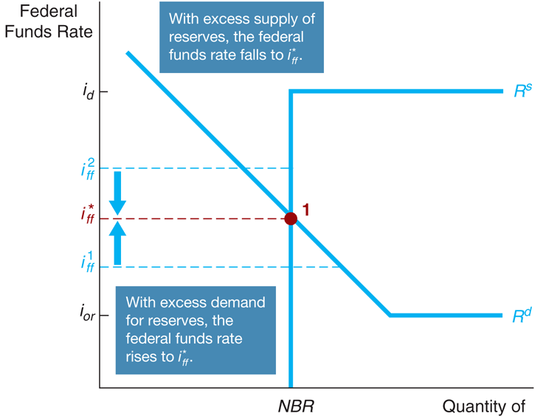
Monetary Policy Tools Equilibrium in the Market for Reserves

Slide 17
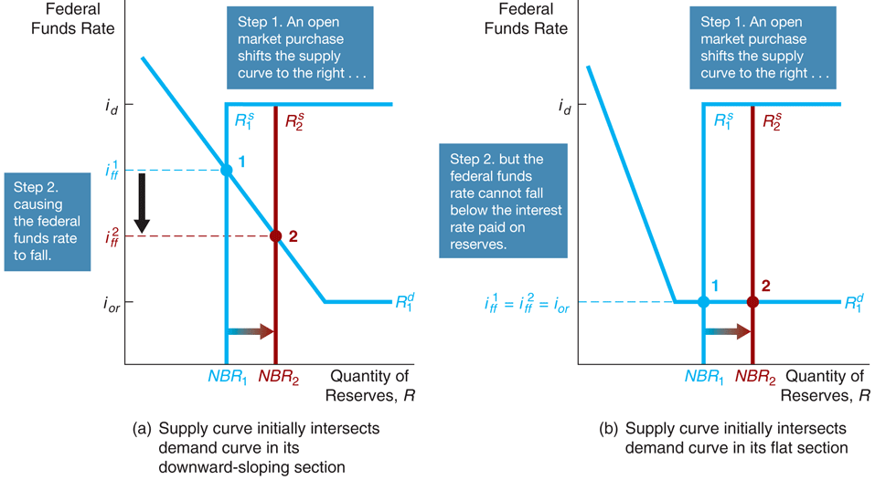
Monetary Policy Tools Response to an OMO
Effects of open an market operation depends on whether the supply curve initially intersects the demand curve in its downward sloped section versus its flat section.
An open market purchase causes the federal funds rate to fall whereas an open market sale causes the federal funds rate to rise (when intersection occurs at the downward sloped section).
Open market operations have no effect on the federal funds rate when intersection occurs at the flat section of the demand curve.

Slide 18
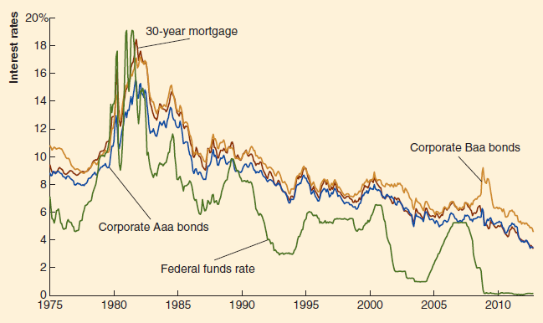
Monetary Policy Tools OMO and the Fed’s Target for the FFR
The Federal Funds Rate and the Interest Rates on Corporate Bonds and Mortgages
The mortgage rate and the corporate bond interest rates generally rise and fall with the federal funds rate.

Slide 19
OMOs
An open market purchase of Treasury securities causes their prices to increase, and so their yield to decrease. As the monetary base increases, the money supply will expand.
An open market purchase is an expansionary policy because it reduces interest rates.
An open market sale has the opposite effects, and so it is called a contractionary policy.

Slide 20
Dynamic vs. Defensive OMOs
Dynamic open market operations are intended to change monetary policy i.e. changing the policy rate.
Defensive open market operations are intended to offset temporary fluctuations in the demand or supply for reserves, not to carry out changes in monetary policy.

Slide 21
Monetary Policy Tools Changes in Discount Rate and Required reserve ratio
Changes in the Discount Rate
Since 2003, the Fed has kept the discount rate higher than the target for the federal funds rate.
So, the discount rate is a penalty rate, as banks pay a penalty by borrowing from the Fed rather than from other banks.
Changes in the Required Reserve Ratio
The Fed rarely changes the required reserve ratio.
This action will likely carry out offsetting open market operations to keep the target for the federal funds rate unchanged.

Slide 22
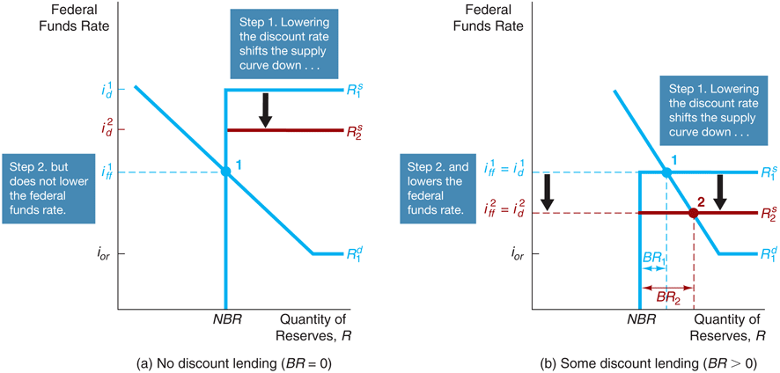
Monetary Policy Tools Response to a Change in the Discount Rate
If the intersection of supply and demand occurs on the vertical section of the supply curve, a change in the discount rate will have no effect on the federal funds rate.
If the intersection of supply and demand occurs on the horizontal section of the supply curve, a change in the discount rate shifts that portion of the supply curve and the federal funds rate may either rise or fall depending on the change in the discount rate

Slide 23
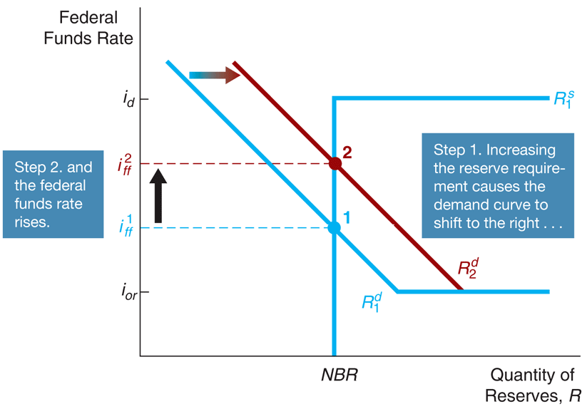
Monetary Policy Tools Response to a Change in Required Reserves
When the Fed raises reserve requirement, the federal funds rate rises and when the Fed decreases reserve requirement, the federal funds rate falls.

Slide 24
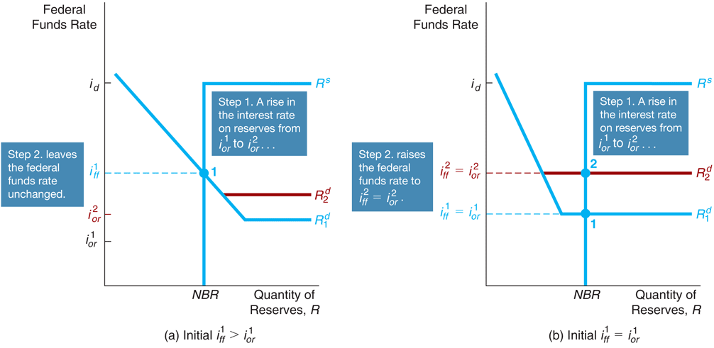
Monetary Policy Tools Response to a Change in the Interest Rate on Reserves

Slide 25
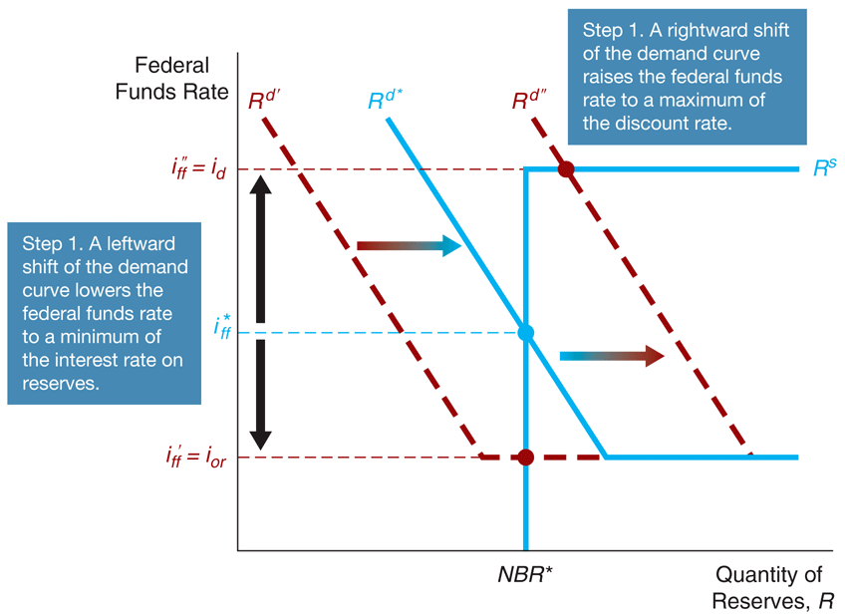
Monetary Policy Tools How the Federal Reserve's Operating Procedures Limit Fluctuations in the Federal Funds Rate?

Slide 26
OMO vs. Other Policy Tools
The benefits of open market operations include control, flexibility, and ease of implementation.
Discount loans depend in part on the willingness of banks to request the loans and so are not as completely under the CBs control.
The CB can make both large and small open market operations. Often, dynamic operations require large purchases or sales whereas defensive operations call for small.
Reversing open market operations is simple for the CB. Discount loans and reserve requirement changes are more difficult to reverse quickly.
The CB can implement its open market operations with no administrative delays. Changing the discount rate or reserve requirements requires lengthier deliberation.

Slide 27
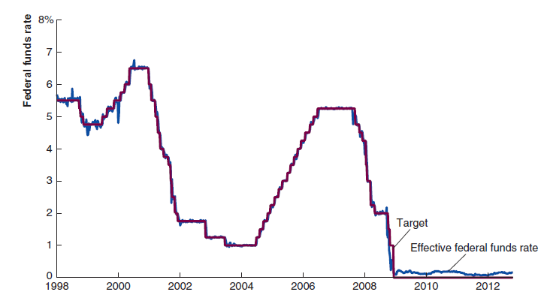
Why Can’t the Fed Always Hits Its Federal Funds Target?
The Fed (or any other central bank) can only set a target for the federal funds rate (policy rate). The actual federal funds rate is determined by the demand and supply for reserves.
The New York Fed has done a good job in using open market operations to keep the actual federal funds rate close to the target rate.

Slide 28
The Failure of Conventional Monetary Policy Tools in a Financial Panic
When the economy experiences a full-scale financial crisis, conventional monetary policy tools cannot do the job, for two reasons.
First, the financial system seizes up to such an extent that it becomes unable to allocate capital to productive uses, and so investment spending and the economy collapse.
Second, the negative shock to the economy can lead to the zero-lower-bound problem.

Slide 29
Nonconventional Monetary Policy Tools During the Global Financial Crisis
Liquidity provision (CREDIT EASING): The Federal Reserve implemented unprecedented increases in its lending facilities to provide liquidity to the financial markets.
Large-scale asset purchases (QUANTITATIVE EASING): During the crisis, the Fed started three new asset purchase programs to lower interest rates for particular types of credit.
Forward Guidance: By committing to the future policy action of keeping the federal funds rate at zero for an extended period, the Fed could lower the market’s expectations of future short-term interest rates, thereby causing the long-term interest rate to fall. (see https://www.afr.com/policy/economy/lowe-admits-embarrassing-error-on-2024-rate-rise-20220503-p5ai9e)
Negative Interest Rates on Banks’ Deposits: Setting negative interest rates on banks’ deposits is supposed to work to stimulate the economy by encouraging banks to lend out the deposits they were keeping at the central bank, thereby encouraging households and businesses to spend more. However, there are doubts that negative interest rates on deposits will have the intended, expansionary effect.

Slide 30
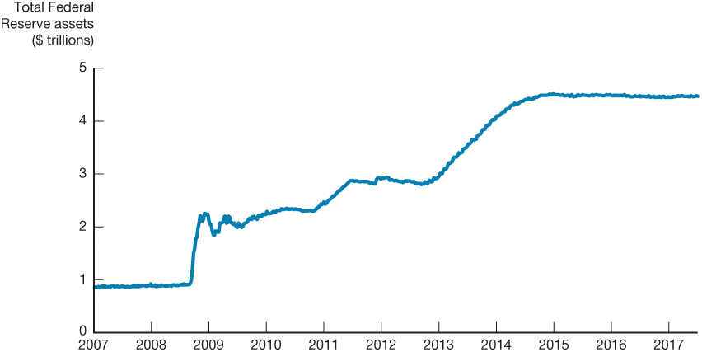
The Expansion of the Federal Balance Sheet, 2007–2014
Recent data

Slide 31
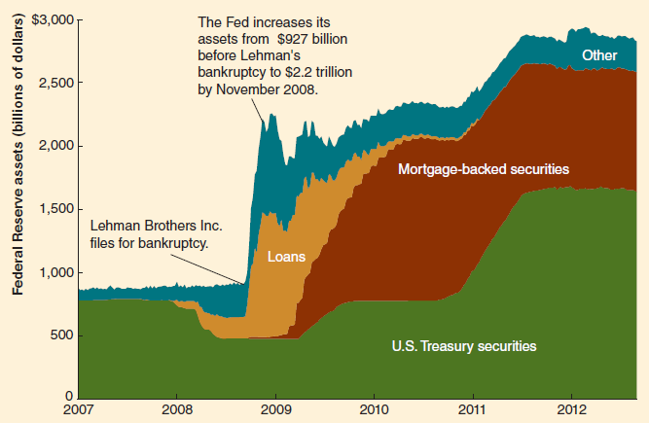
Quantitative Easing
Federal Reserve Assets 2007-2012
After the collapse of Lehman Brothers, the Fed dramatically increased its assets through loans to financial institutions and purchases of assets such as commercial paper and mortgage-backed securities.

Slide 32
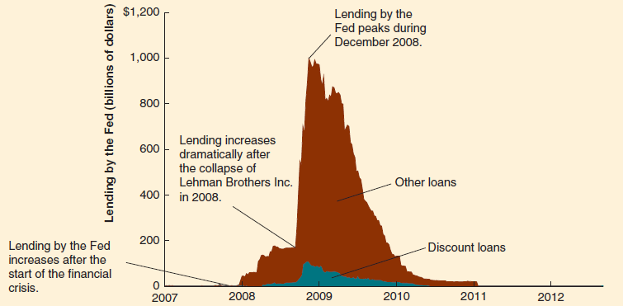
Discount Lending during the Financial Crisis of 2007-2009
During the financial crisis, lending by the Fed increased from just a few hundred million dollars to $993.5 billion in December 2008.

Slide 33
More on the Monetary Policy Tools Monetary Targeting and Monetary Policy
The Fed often faces trade-offs in attempting to reach its goals, particularly the goals of high economic growth and low inflation.
To spur economic growth, the Fed could lower the target for the federal funds rate, which increase the money supply, potentially increasing the inflation rate in the longer run.
The tools of monetary policy don’t allow the Fed to have direct control over real output or the price level.

Slide 34
More on the Monetary Policy Tools Monetary Targeting and Monetary Policy
The Fed also faces timing difficulties:
The information lag refers to the Fed’s inability to observe instantaneously changes in economic variables.
The impact lag is the time that is required for monetary policy changes to affect output, employment, or inflation.
One possible solution to those timing problems is for the Fed to use targets to meet its goals.

Slide 35
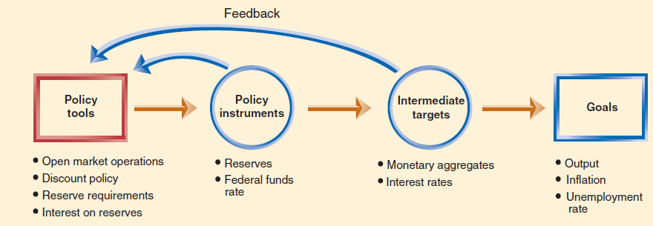
More on the Monetary Policy Tools Monetary Targeting and Monetary Policy
The Fed establishes goals, but it directly controls only its policy tools.
So it can use targets to help achieve monetary policy goals.

Slide 36
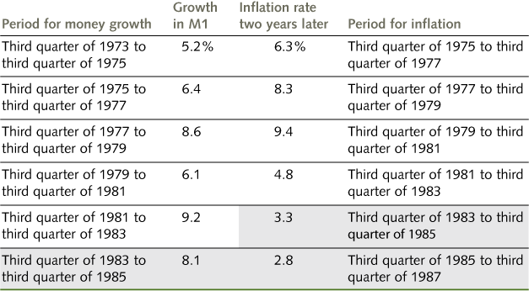
More on the Fed’s Monetary Policy Tools What Happened to the Link Between Money and Prices
In the United States, the money supply has grown more rapidly during decades when the inflation rate has been relatively high.
Prior to 1980, strong evidence supports the link between money and prices in the short run of a year or two.
The economists who argued this point most forcefully were known as monetarists, notably Nobel laureate Milton Friedman.
After 1980, the short-run link between the growth of the money supply and inflation broke down.

Slide 37
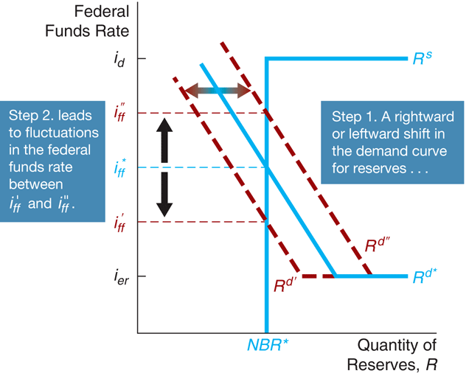
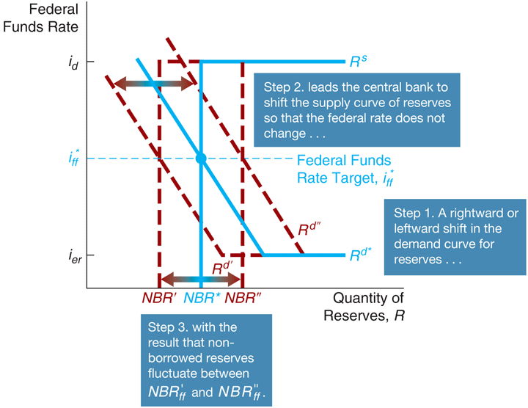
More on the Monetary Policy Tools Reserves vs. Federal Funds Rate
Targeting on Reserves
Targeting on the Federal Funds Rate

Slide 38
More on the Monetary Policy Tools Reserves vs. Federal Funds Rate
The Fed faces a trade-off:
It can choose a reserve aggregate for its policy instrument, or it can choose the federal funds rate, but it cannot choose both.
Using reserves as the Fed’s policy instrument will cause the federal funds rate to fluctuate in response to changes in the demand for reserves.
Using the federal funds rate as the policy instrument will cause the level of reserves to fluctuate in response to changes in the demand for reserves.
By the 1980s, the Fed had concluded that the link between the federal funds rate and its policy goals was closer than the link between the level of reserves and its policy goals.
So, the federal funds rate has been the Fed’s policy instrument for the past 30 years

Slide 39
More on the Monetary Policy Tools The Taylor Rule: A Summary Measure of Central Bank Policy
Actual CB deliberations are complex and incorporate many factors about the economy.
John Taylor of Stanford University has summarized these factors in the Taylor rule.
Taylor rule is a monetary policy guideline developed by economist John Taylor for determining the target for the federal funds rate.
The Taylor rule is an estimate of the value of the federal funds rate (after adjustment for inflation) to be consistent with real GDP being equal to potential real GDP in the long run.
See Taylor Rule

Slide 40
More on the Monetary Policy Tools The Taylor Rule: A Summary Measure of Fed Policy
According to the Taylor rule, the Fed should set its current federal funds rate target equal to the current inflation rate, the equilibrium real federal funds rate, and two additional terms.
The first of these terms is the inflation gap – the difference between current inflation and a target rate; the second is the output gap – the percentage difference of real GDP from potential real GDP.
The inflation gap and the output gap are each given “weights” that reflect their influence on the federal funds rate target. With weights of one half for both gaps, we have the following Taylor rule:
Federal funds target=Current inflation rate + Equilibrium real funds rate + (1/2 x Inflation gap) + (1/2 x Output gap)

Slide 41
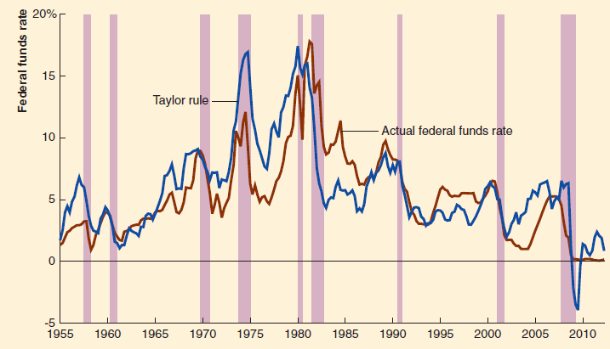
More on the Monetary Policy Tools The Taylor Rule: A Summary Measure of Fed Policy
The blue line shows the level of the federal funds rate according to the Taylor rule.
The red line shows the target federal funds rate.
The Taylor rule does a reasonable job of explaining Fed policy during some periods.
Current Data

Slide 42
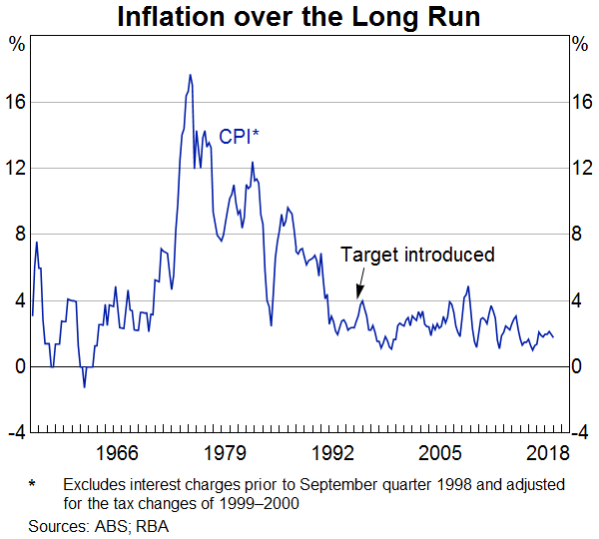
More on the Monetary Policy Tools Inflation Targeting
With inflation targeting, a central bank publically sets an explicit target for the inflation rate over a period of time.
The RBA introduced inflation targeting in early 1990s. The Governor and the Treasurer agreed that he appropriate target is 2-3% inflation rate.
Current Data

Slide 43
More on the Monetary Policy Tools Inflation Targeting
Arguments in favor of an explicit inflation targeting
Arguments against an inflation targeting
Rigid numerical targets for inflation diminish flexibility.
Reliance on uncertain forecasts of future inflation can create problems.
The focus on inflation may make it more difficult for elected officials to monitor the CB’s support for good economic policy overall.
Uncertainty about future levels of output and employment can impede economic decision making in the presence of an inflation target.
It would draw attention to what the Central Bank can actually achieve in practice.
It would provide an anchor for inflationary expectations.
It would help institutionalize effective monetary policy.
It would promote accountability.
More Info

Slide 44
What is next?
Exchange rates...

